Slide 1

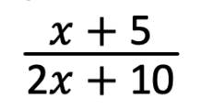
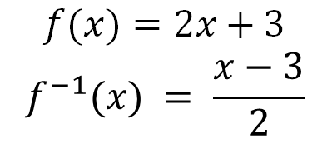
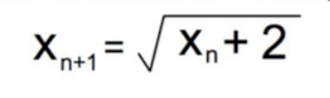
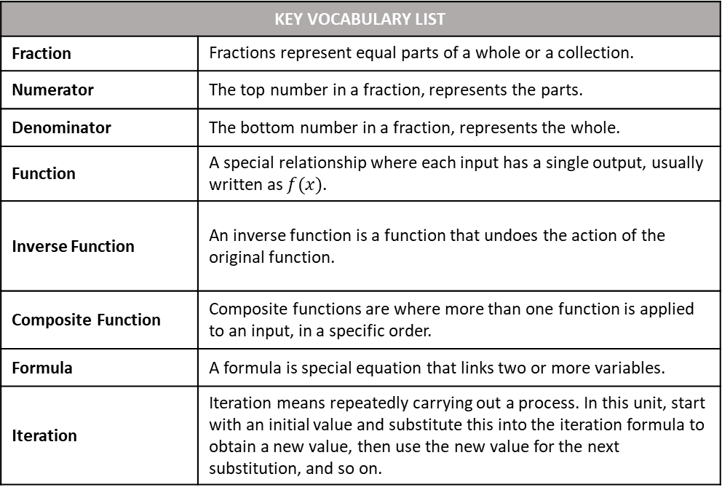
Name
Class
Tutor Group
YEAR 11 MATHEMATICS
Unit 1: Further Algebra (PART 1) PART 1: Rearranging Formulae, Simultaneous Equations (including Quadratic Simultaneous Equations)
KEY VOCABULARY LIST
Fraction | Fractions represent equal parts of a whole or a collection.
Numerator | The top number in a fraction, represents the parts.
Denominator | The bottom number in a fraction, represents the whole.
Function | A special relationship where each input has a single output, usually written as $f(x)$.
Inverse Function | An inverse function is a function that undoes the action of the original function.
Composite Function | Composite functions are where more than one function is applied to an input, in a specific order.
Formula | A formula is special equation that links two or more variables.
Iteration | Iteration means repeatedly carrying out a process. In this unit, start with an initial value and substitute this into the iteration formula to obtain a new value, then use the new value for the next substitution, and so on.

Slide 2
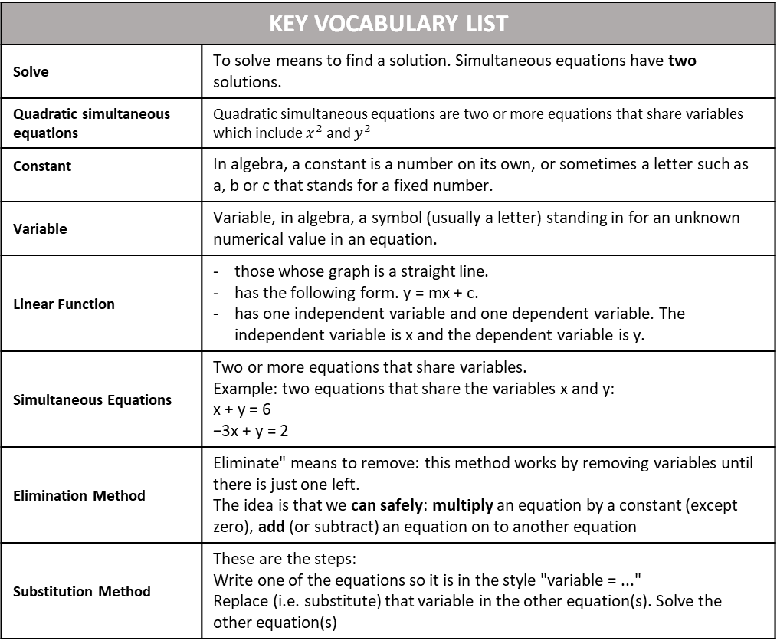
KEY VOCABULARY LIST
Solve | To solve means to find a solution. Simultaneous equations have two solutions.
Quadratic simultaneous equations | Quadratic simultaneous equations are two or more equations that share variables which include $x^{2}$ and $y^{2}$
Constant | In algebra, a constant is a number on its own, or sometimes a letter such as a, b or c that stands for a fixed number.
Variable | Variable, in algebra, a symbol (usually a letter) standing in for an unknown numerical value in an equation.
Linear Function | those whose graph is a straight line. has the following form. y = mx + c. has one independent variable and one dependent variable. The independent variable is x and the dependent variable is y.
Simultaneous Equations | Two or more equations that share variables. Example: two equations that share the variables x and y: x + y = 6 −3x + y = 2
Elimination Method | Eliminate" means to remove: this method works by removing variables until there is just one left. The idea is that we can safely: multiply an equation by a constant (except zero), add (or subtract) an equation on to another equation
Substitution Method | These are the steps: Write one of the equations so it is in the style "variable = ..." Replace (i.e. substitute) that variable in the other equation(s). Solve the other equation(s)

Slide 3
CONTENTS |  | PAGE
SUBTOPIC 1 | Rearranging Formulae/ Changing the Subject | 5
 | GCSE QUESTIONS | 16
SUBTOPIC 2 | Recap/ Prior Knowledge Quiz: Solving Quadratic Equations | 20
SUBTOPIC 3a | Simultaneous Equations – elimination and graphical solving | 25
SUBTOPIC 3b | Recap: Solving Simultaneous Equations by Elimination | 32
SUBTOPIC 3c | Worded Simultaneous Equations | 47
 | GCSE QUESTIONS | 52
SUBTOPIC 3d | Solving Simultaneous Equations using Substitution | 56
SUBTOPIC 3e | Quadratic Simultaneous Equations | 58
 | GCSE QUESTIONS | 68
SUBTOPIC 4a | Algebraic Fractions – Manipulation and Simplifying
 | GCSE QUESTIONS
SUBTOPIC 4b | Algebraic Fractions – Solving (including Quadratics)
 | GCSE QUESTIONS
SUBTOPIC 5 | Functions
 | GCSE QUESTIONS
SUBTOPIC 6a | Iteration 1: Recurrence Relationships
 | GCSE QUESTIONS
SUBTOPIC 6b | Iteration 2: Estimating Solutions
 | GCSE QUESTIONS
SUBTOPIC 7 | Algebraic Proof
 | GCSE QUESTIONS
BOOKLET STRUCTURE
Start of subtopic:
Read and annotate the information in the Frayer model or introduction text
I do (teacher led example).
We do (teacher and scholar led example).
You do (independent scholar example).
Whiteboard check.
Independent practice and mixed practice.
End of subtopic:
GCSE questions – to ensure you are confident with the style you will encounter in your exams

Slide 4
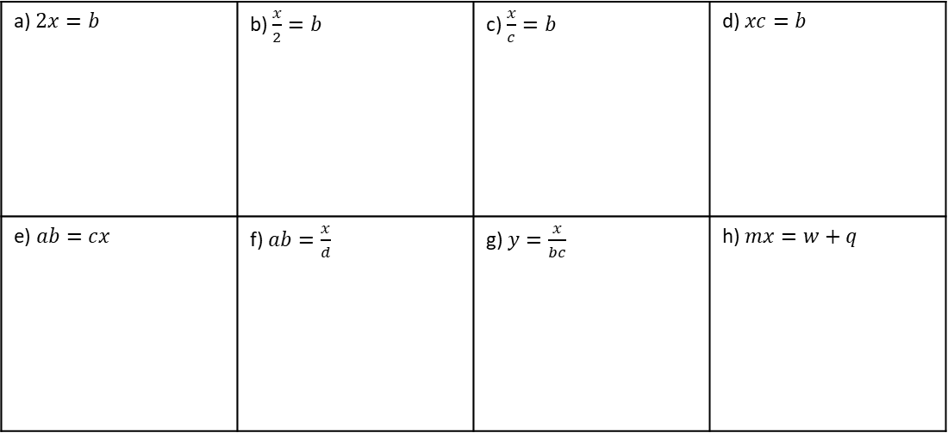
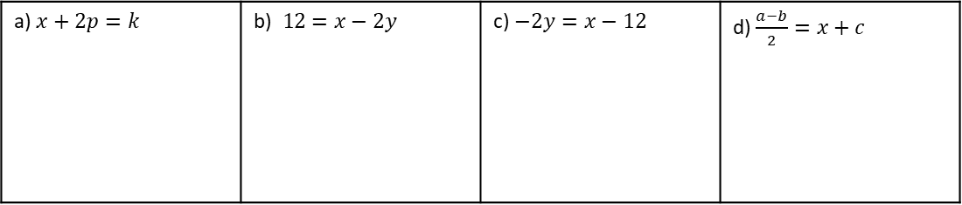
Subtopic 1 – Rearranging Formulae/ Changing the Subject
LEARNING OUTCOME: To be fluent when rearranging formulae/ changing the subject
Objectives:
Keywords:
Equation
Subject
Inverse
Formulae
To be able to rearrange formulae with one-step
To be able to rearrange formulae with two-steps
To be able to rearrange formulae requiring many-steps
Introduction/Recap
Rearranging formulae is a lot like solving equations—you still use inverse operations on both sides to
keep things balanced. The difference is, instead of finding a number, you're working to make a
specific variable (called the subject) stand alone. Making a variable the subject means rewriting the
equation so that it’s isolated on one side, usually the left. This lets you express that variable in terms
of the others. This is sometimes called changing the subject.
Prior Knowledge Quiz – One Step Rearranging
There are many types of ‘rearranging’ and ‘changing the subject’ questions – they can be simple or get very challenging. The Quiz on the pages below should be attempted individually, and your teacher will assess how much recapping is needed before you move on to more advanced algebra topics. The later topics generally rely on you being able to rearrange formulae fluently.
Question 1. Make $x$ the subject of the following:
a) $x+2p=k$ | b)$12=x−2y12=x−2y$ | c) $−2y=x−12$ | d) $\frac{a−b}{2}=x+c$
Question 2. Make $x$ the subject of the following:
a) $2x=b$ | b) $\frac{x}{2}=b$ | c) $\frac{x}{c}=b$ | d) $xc=b$
e) $ab=cx$ | f) $ab=\frac{x}{d}$ | g) $y=\frac{x}{bc}$ | h) $mx=w+q$

Slide 5
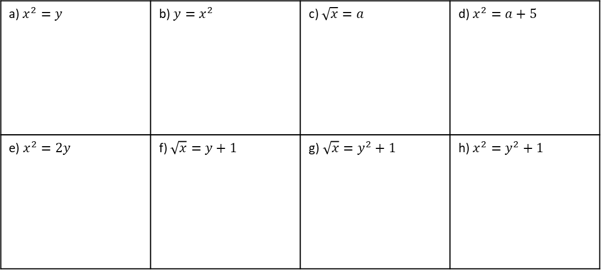
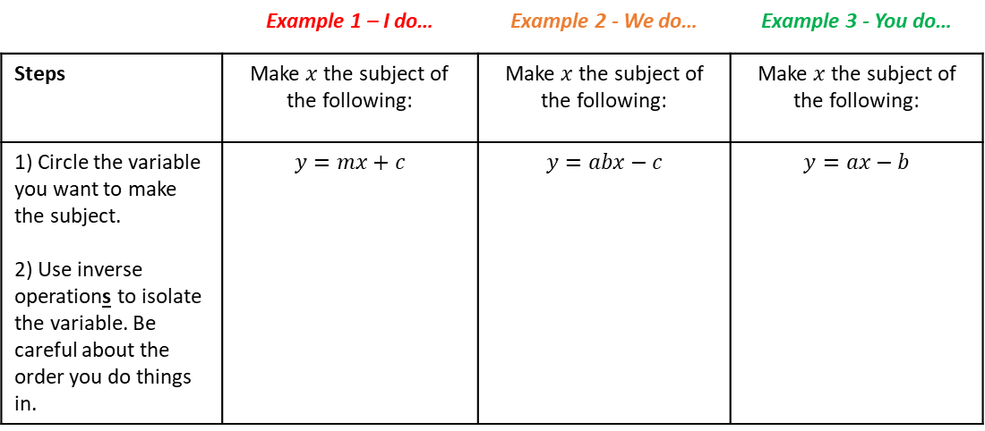
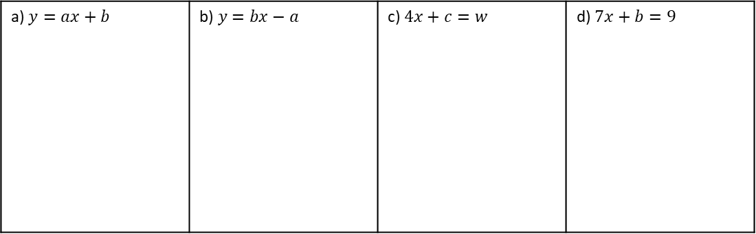
Question 3. Make $x$ the subject of the following:
a) $x^{2}=y$ | b) $y=x^{2}$ | c) $\sqrt{x}=a$ | d) $x^{2}=a+5$
e) $x^{2}=2y$ | f) $\sqrt{x}=y+1$ | g)$\sqrt{x}=y^{2}+1$ | h) $x^{2}=y^{2}+1$
Two step rearranging (addition/ subtraction with division)
 | Example 1 – I do… | Example 2 - We do… | Example 3 - You do…
Steps | Make $x$ the subject of the following: | Make $x$ the subject of the following: | Make $x$ the subject of the following:
1) Circle the variable you want to make the subject. 2) Use inverse operations to isolate the variable. Be careful about the order you do things in. | $$y=mx+c$$ | $$y=abx−c$$ | $$y=ax−b$$
Independent Practice
Question 1. Make $x$ the subject of the following:
a) $y=ax+b$ | b)$y=bx−a$ | c) $4x+c=w$ | d) $7x+b=9$

Slide 6
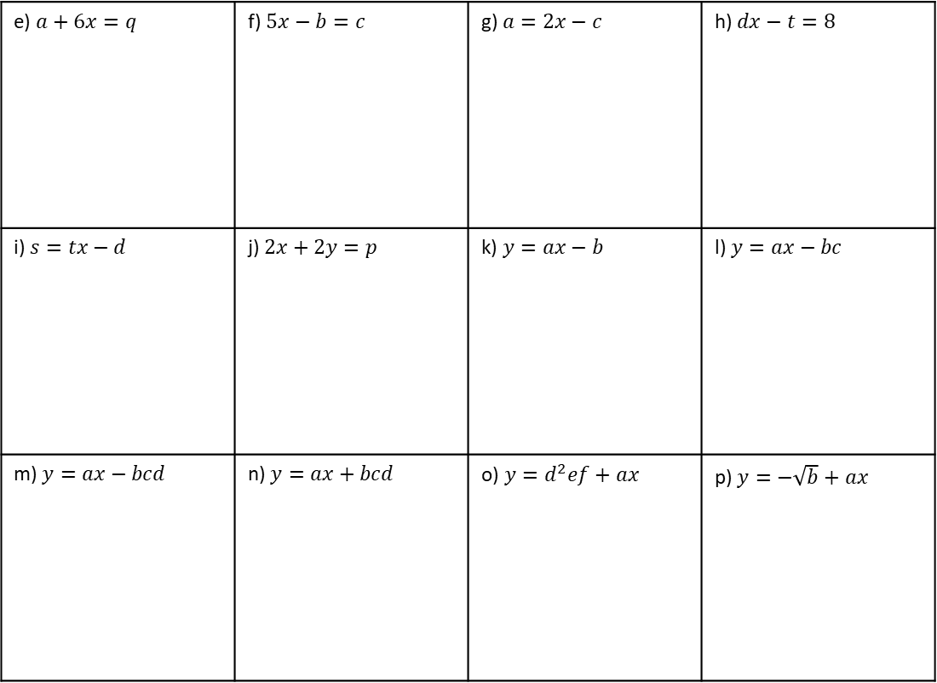
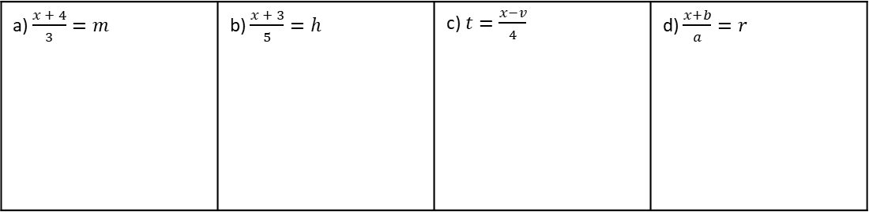
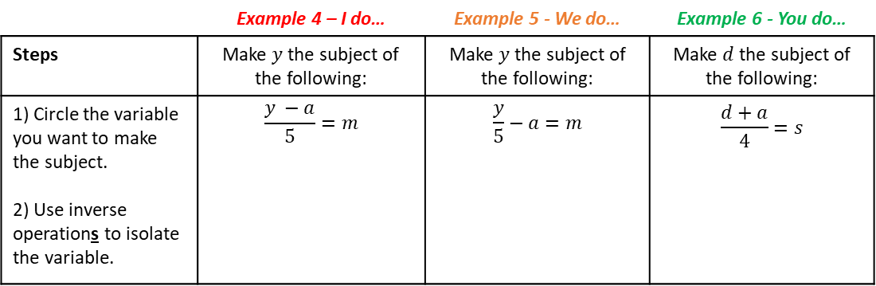
e) $a+6x=q$ | f) $5x−b=c$ | g) $a=2x−c$ | h) $dx−t=8$
i) $s=tx−d$ | j) $2x+2y=p$ | k) $y=ax−b$ | l) $y=ax−bc$
m) $y=ax−bcd$ | n) $y=ax+bcd$ | o) $y=d^{2}ef+ax$ | p) $y=−\sqrt{b}+ax$
Two step rearranging (addition/ subtraction with multiplication)
 | Example 4 – I do… | Example 5 - We do… | Example 6 - You do…
Steps | Make $y$ the subject of the following: | Make $y$ the subject of the following: | Make $d$ the subject of the following:
1) Circle the variable you want to make the subject. 2) Use inverse operations to isolate the variable. | $$\frac{y −a}{5}=m$$ | $$\frac{y}{5}−a=m$$ | $$\frac{d+a}{4}=s$$
Independent Practice
Question 2. Make $x$ the subject of the following:
a) $\frac{x + 4}{3}=m$ | b) $\frac{x + 3}{5}=h$ | c) $t=\frac{x−v}{4}$ | d) $\frac{x+b}{a}=r$

Slide 7
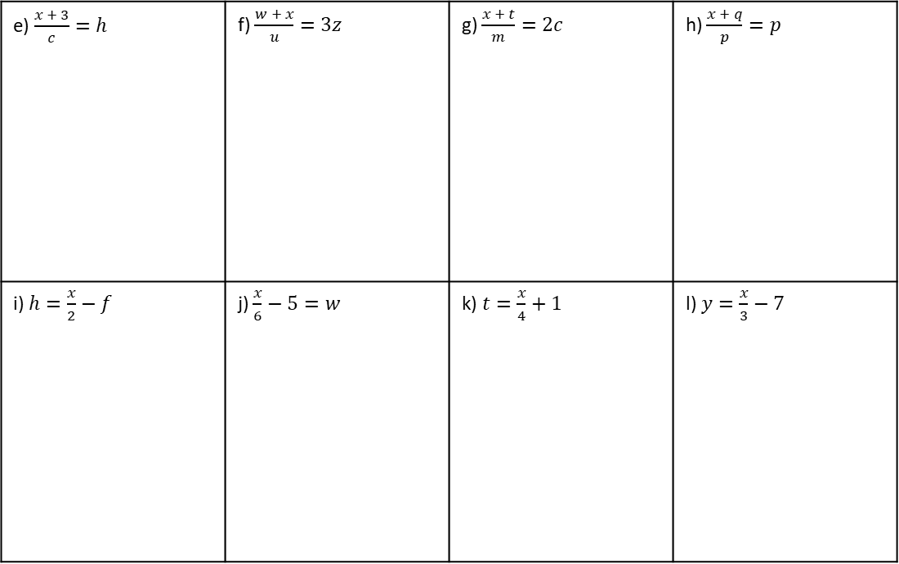
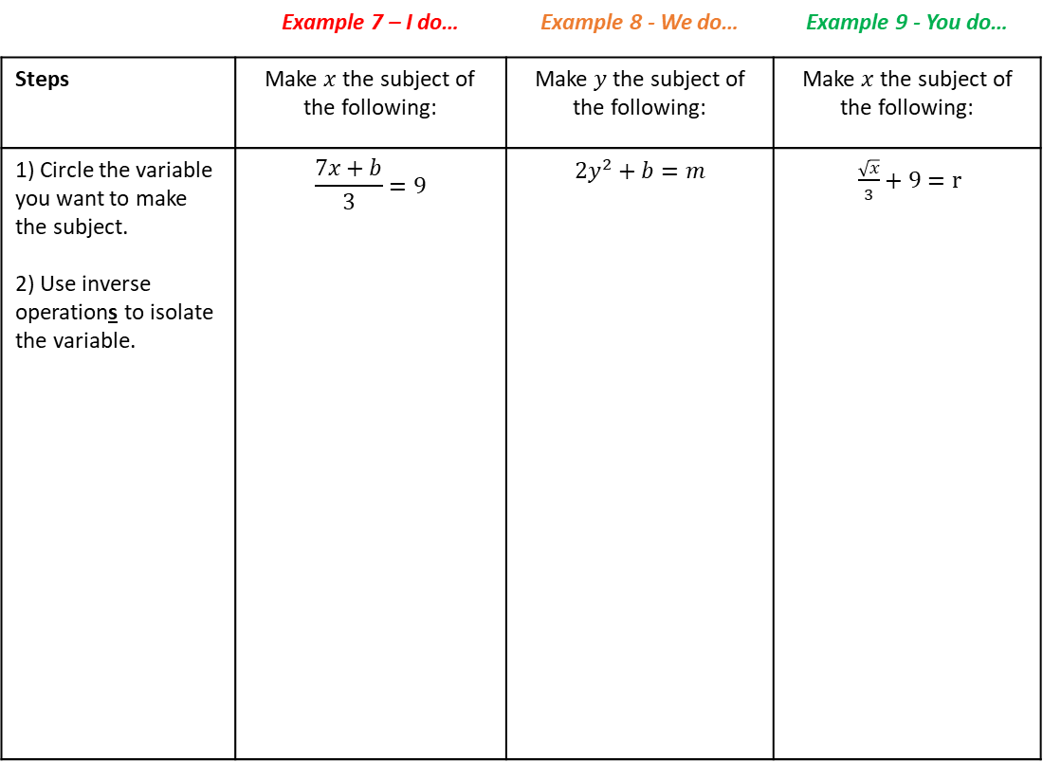
e) $\frac{x + 3}{c}=h$ | f) $\frac{w + x}{u}=3z$ | g) $\frac{x + t}{m}=2c$ | h) $\frac{x + q}{p}=p$
i) $h=\frac{x}{2}−f$ | j) $\frac{x}{6}−5=w$ | k) $t=\frac{x}{4}+1$ | l) $y=\frac{x}{3}−7$
Multi-step rearranging
 | Example 7 – I do… | Example 8 - We do… | Example 9 - You do…
Steps | Make $x$ the subject of the following: | Make $y$ the subject of the following: | Make $x$ the subject of the following:
1) Circle the variable you want to make the subject. 2) Use inverse operations to isolate the variable. | $$\frac{7x+b}{3}=9$$ | $$2y^{2}+b=m$$ | $\frac{\sqrt{x}}{3}+9=r$

Slide 8
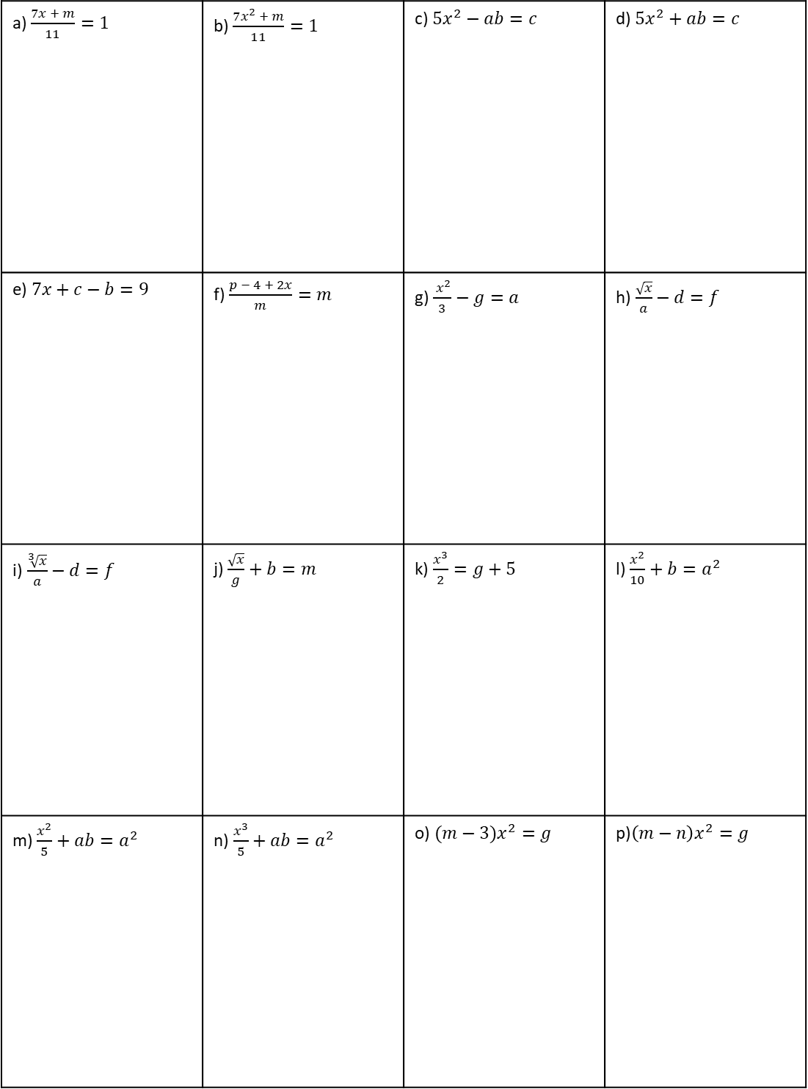
Independent Practice
Question 3. Make $x$ the subject of the following:
a) $\frac{7x + m}{11}=1$ | b) $\frac{7x^{2} + m}{11}=1$ | c) $5x^{2}−ab=c$ | d) $5x^{2}+ab=c$
e)$7x+c−b=9$ | f) $\frac{p − 4 + 2x}{m}=m$ | g) $\frac{ x^{2}}{3}−g=a$ | h)$\frac{\sqrt{x}}{a}−d=f$
i)$\frac{\sqrt[3]{x}}{a}−d=f$ | j) $\frac{\sqrt{x}}{g}+b=m$ | k) $\frac{x^{3}}{2}=g+5$ | l) $\frac{x^{2}}{10}+b=a^{2}$
m) $\frac{x^{2}}{5}+ab=a^{2}$ | n)$\frac{x^{3}}{5}+ab=a^{2}$ | o) $(m−3)x^{2}=g$ | p)$\left(m−n\right)x^{2}=g$

Slide 9
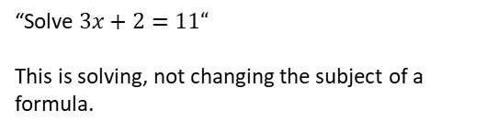
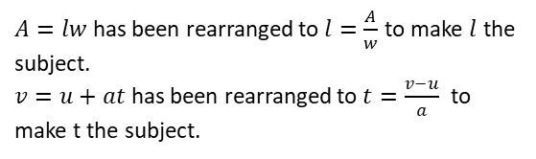
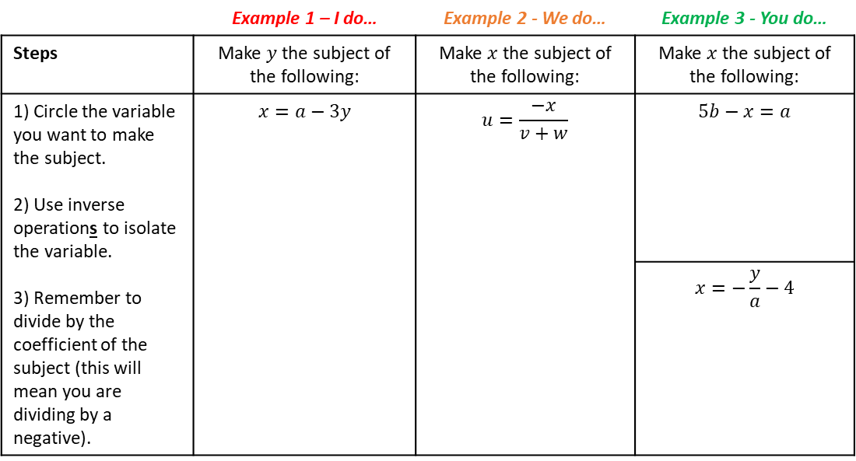
Rearranging More Complex Formulae
LEARNING OUTCOME: To be able to rearrange more complex formulae
Objectives:
Keywords:
Equation
Subject
Inverse
Formulae
To be able to rearrange equations with negative unknowns
To be able to rearrange equations with the subject in the denominator
To be able to rearrange equations where the subject appears more than once
Introduction
When rearranging more complex equations, you’ll use the same basic steps, but things can get a bit
trickier. You might have to deal with negative variables, variables in the denominator, or even the
subject appearing more than once. In these cases, you may need to multiply both sides to eliminate
fractions, move terms carefully, and sometimes factorise expressions to get the subject on its own. It
takes a few more steps, but the key is still to use inverse operations and keep both sides balanced.
Definition
Characteristics
Changing the subject of a formula means rearranging the formula to make a different variable the subject (i.e., on its own on one side of the equals sign).
Involves inverse operations (e.g., undoing addition with subtraction) and works step-by-step like solving an equation, keeping the equation balanced on both sides.
The subject is the variable you’re isolating.
Examples
Changing the subject
Non - Examples
$A=lw$ has been rearranged to $l=\frac{A}{w}$ to make $l$ the subject.
$v=u+at$ has been rearranged to $t=\frac{v−u}{a}$ to make t the subject.
“Solve $3x+2=11“$
This is solving, not changing the subject of a formula.
Rearranging with negative unknowns
 | Example 1 – I do… | Example 2 - We do… | Example 3 - You do…
Steps | Make $y$ the subject of the following: | Make $x$ the subject of the following: | Make $x$ the subject of the following:
1) Circle the variable you want to make the subject. 2) Use inverse operations to isolate the variable. 3) Remember to divide by the coefficient of the subject (this will mean you are dividing by a negative). | $$x=a−3y$$ | $$u=\frac{−x}{v+w}$$ | $$5b−x=a$$
 |  |  | $$x=−\frac{y}{a}−4$$

Slide 10
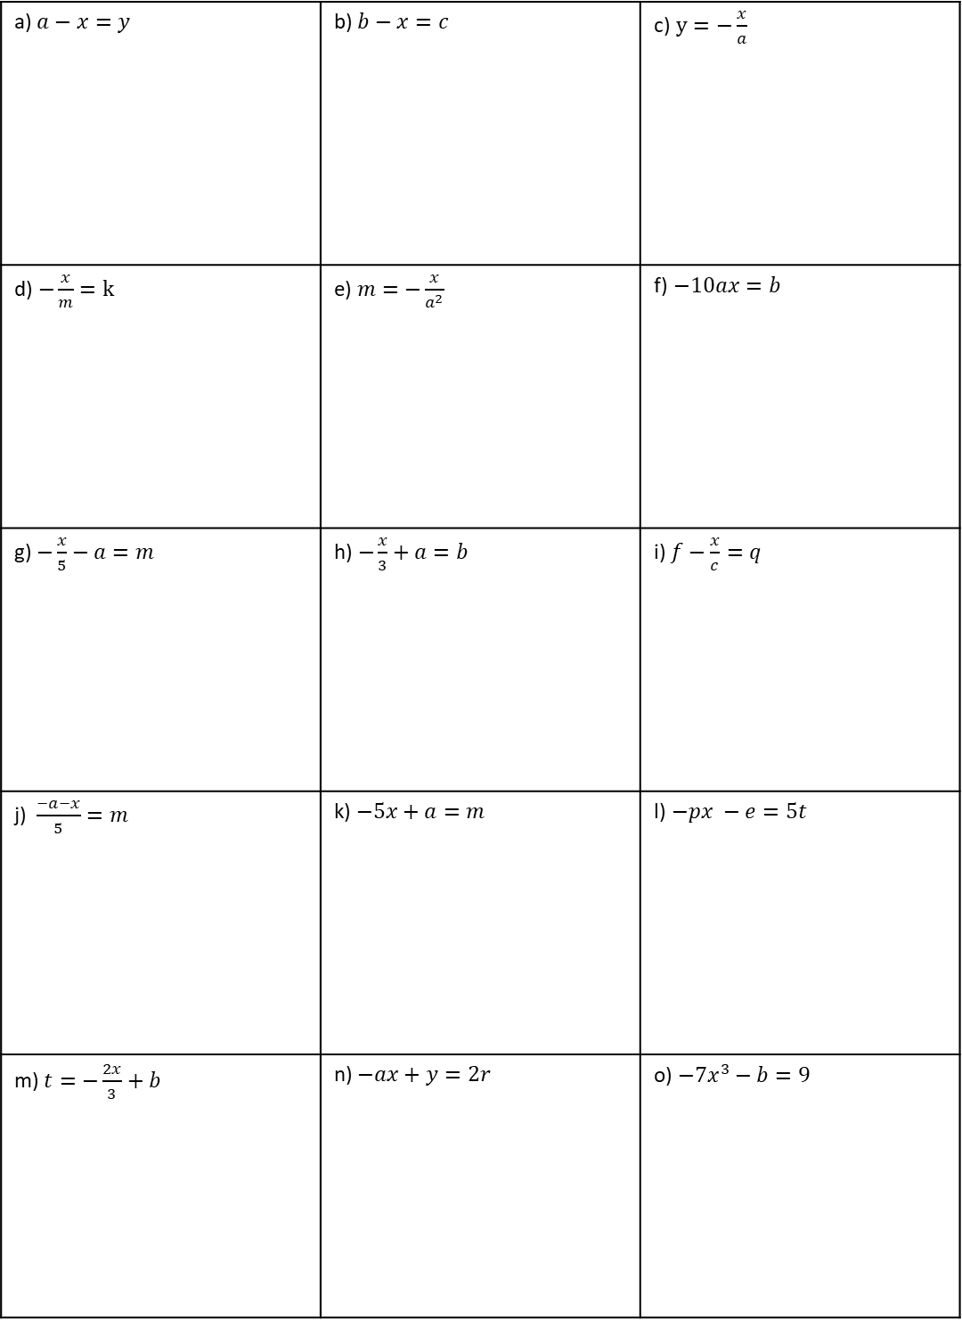
Independent Practice
Question 1. Make $x$ the subject of the following:
a) $a−x=y$ | b) $b−x=c$ | c)$y=−\frac{x}{a}$
d)$−\frac{x}{m}=k$ | e)$m=−\frac{x}{a^{2}}$ | f)$−10ax=b$
g) $−\frac{x}{5}−a=m$ | h)$−\frac{x}{3}+a=b$ | i) $f−\frac{x}{c}=q$
j)$\frac{−a−x}{5}=m$ | k) $−5x+a=m$ | l)$−px −e=5t$
m) $t=−\frac{2x}{3}+b$ | n) $−ax+y=2r$ | o) $−7x^{3}−b=9$

Slide 11
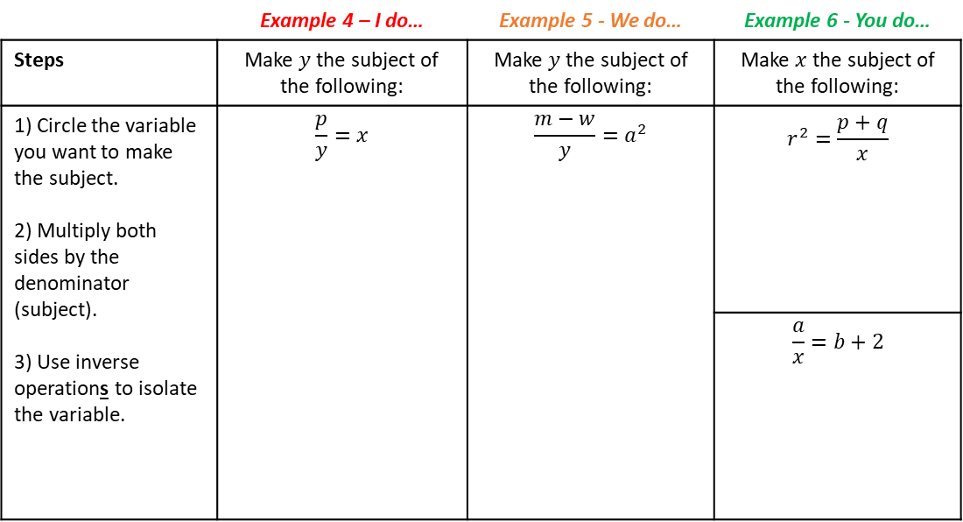
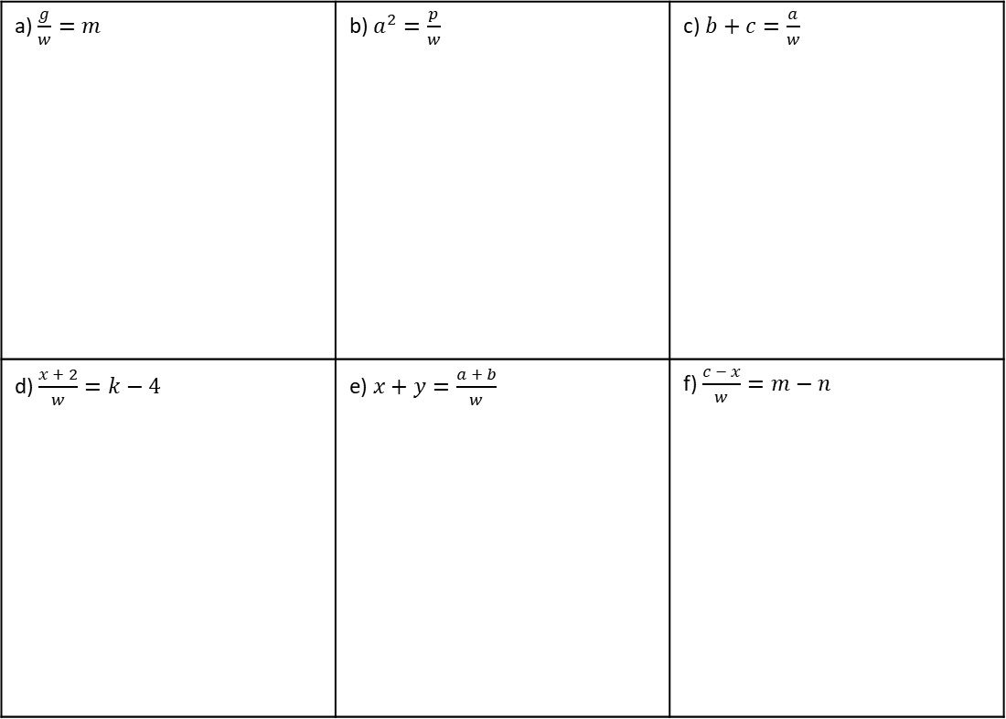
Rearranging with the subject in the denominator
 | Example 4 – I do… | Example 5 - We do… | Example 6 - You do…
Steps | Make $y$ the subject of the following: | Make $y$ the subject of the following: | Make $x$the subject of the following:
1) Circle the variable you want to make the subject. 2) Multiply both sides by the denominator (subject). 3) Use inverse operations to isolate the variable. | $$\frac{p}{y}=x$$ | $$\frac{m−w}{y}=a^{2}$$ | $$r^{2}=\frac{p+q}{x}$$
 |  |  | $$\frac{a}{x}=b+2$$
Independent Practice
Question 2. Make $w$ the subject of the following:
a) $\frac{g}{w}=m$ | b) $a^{2}=\frac{p}{w}$ | c) $b+c=\frac{a}{w}$
d) $\frac{x + 2}{w}=k−4$ | e) $x+y=\frac{a + b}{w}$ | f) $\frac{c − x}{w}=m−n$

Slide 12
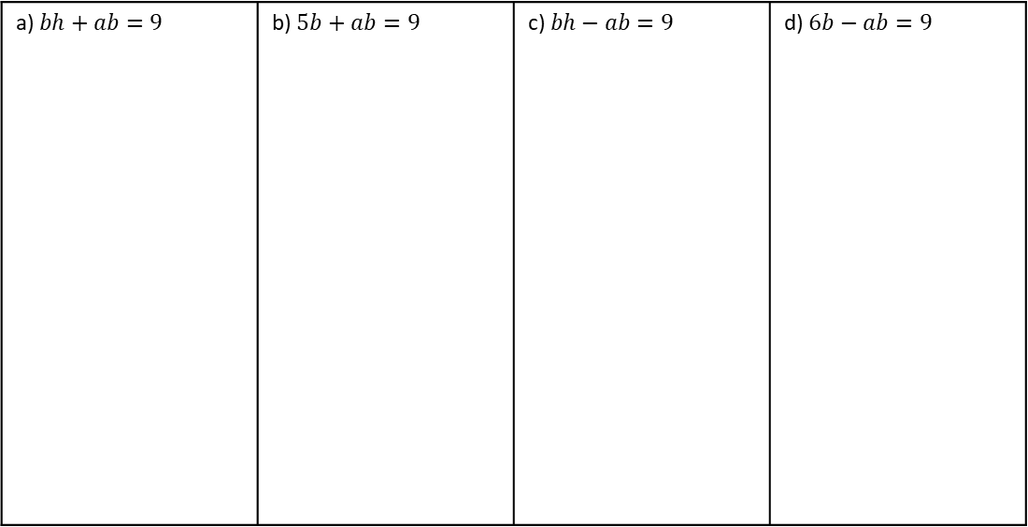
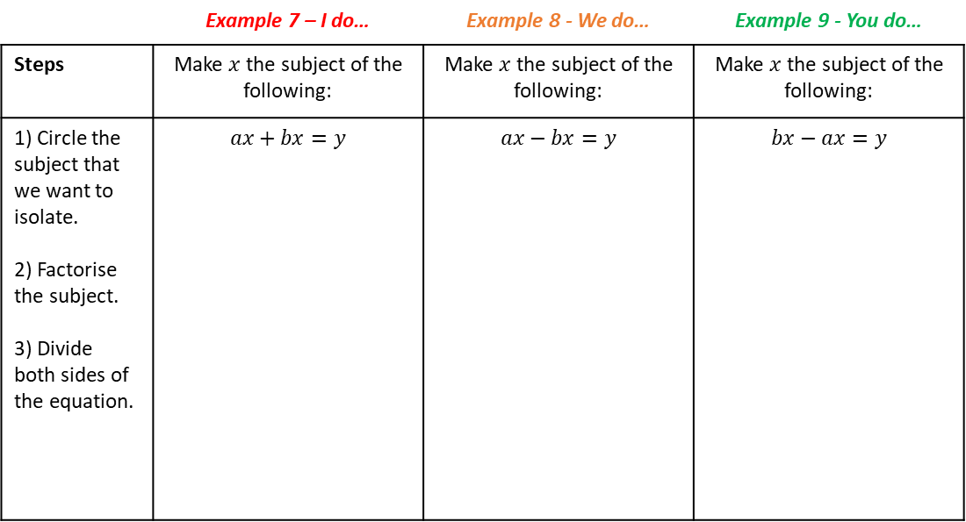
Rearranging where the subject appears twice
Introduction
Sometimes, when rearranging a formula, the variable you want to make the subject appears more
than once. In this case, you can’t isolate it right away—you first need to collect all the terms
containing that variable on one side of the formula. Then, you factorise by taking the variable out,
which means writing it once, multiplied by a bracket. This makes it possible to divide and fully isolate
the subject. It’s an extra step, but it follows the same logic: work step by step to get the subject by
itself. In this section you will practice a series of increasingly difficult question types that involve
factorising, while incorporating all of the previous rearranging knowledge you have acquired.
 | Example 7 – I do… | Example 8 - We do… | Example 9 - You do…
Steps | Make $x$ the subject of the following: | Make $x$ the subject of the following: | Make $x$ the subject of the following:
1) Circle the subject that we want to isolate. 2) Factorise the subject. 3) Divide both sides of the equation. | $$ax+bx=y$$ | $$ax−bx=y$$ | $$bx−ax=y$$
Independent Practice
Question 3. Make $b$ the subject of the following:
a) $bh+ab=9$ | b) $5b+ab=9$ | c) $bh−ab=9$ | d) $6b−ab=9$

Slide 13
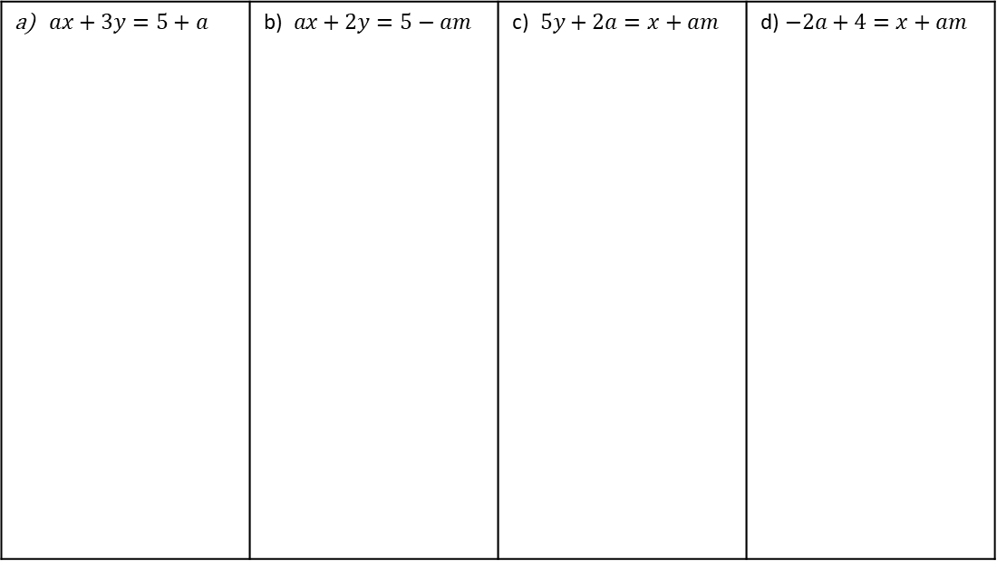
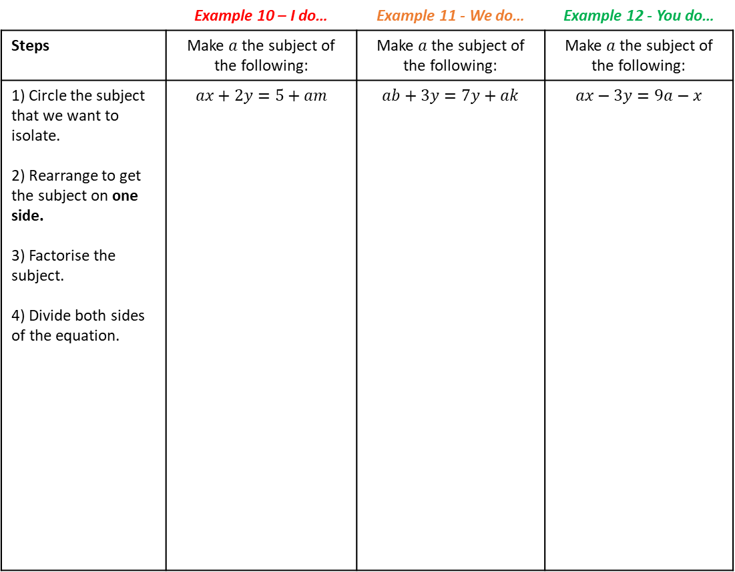
 | Example 10 – I do… | Example 11 - We do… | Example 12 - You do…
Steps | Make $a$the subject of the following: | Make $a$ the subject of the following: | Make $a$ the subject of the following:
1) Circle the subject that we want to isolate. 2) Rearrange to get the subject on one side. 3) Factorise the subject. 4) Divide both sides of the equation. | $$ax+2y=5+am$$ | $$ab+3y=7y+ak$$ | $$ax−3y=9a−x$$
Independent Practice
Question 4. Make $a$the subject of the following:
$ax+3y=5+a$ | b)$ax+2y=5−am$ | c)$5y+2a=x+am$ | d)$−2a+4=x+am$

Slide 14
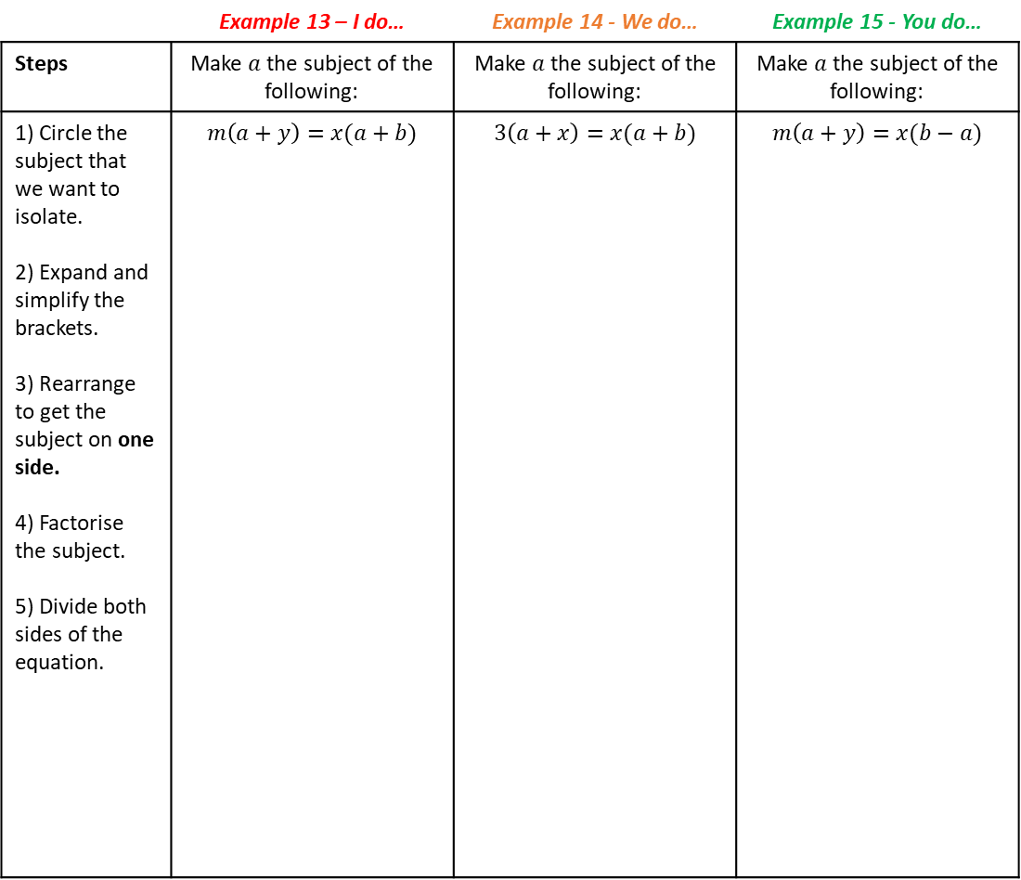
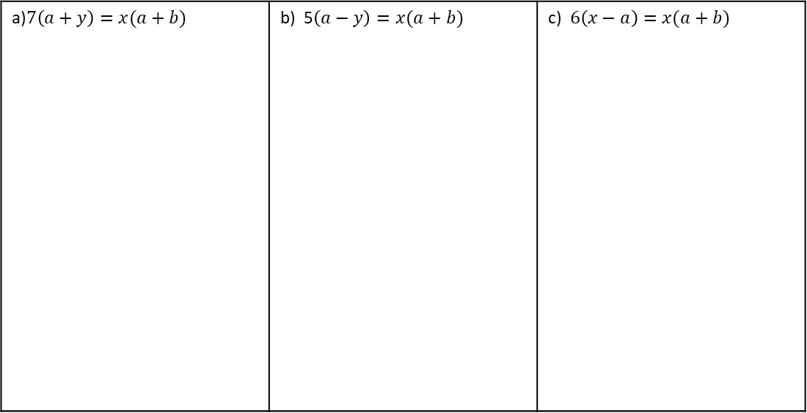
 | Example 13 – I do… | Example 14 - We do… | Example 15 - You do…
Steps | Make $a$the subject of the following: | Make $a$ the subject of the following: | Make $a$ the subject of the following:
1) Circle the subject that we want to isolate. 2) Expand and simplify the brackets. 3) Rearrange to get the subject on one side. 4) Factorise the subject. 5) Divide both sides of the equation. | $$m\left(a+y\right)=x(a+b)$$ | $$3\left(a+x\right)=x(a+b)$$ | $$m\left(a+y\right)=x(b−a)$$
Independent Practice
Question 6. Make $a$ the subject of the following:
a)$7\left(a+y\right)=x(a+b)$ | b) 5$\left(a−y\right)=x(a+b)$ | c) $6\left(x−a\right)=x(a+b)$

Slide 15
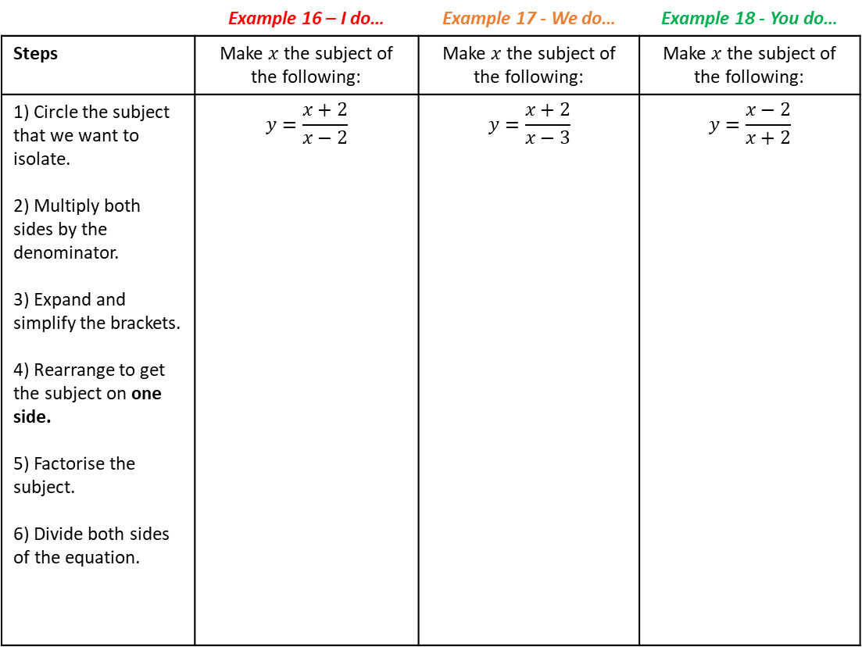
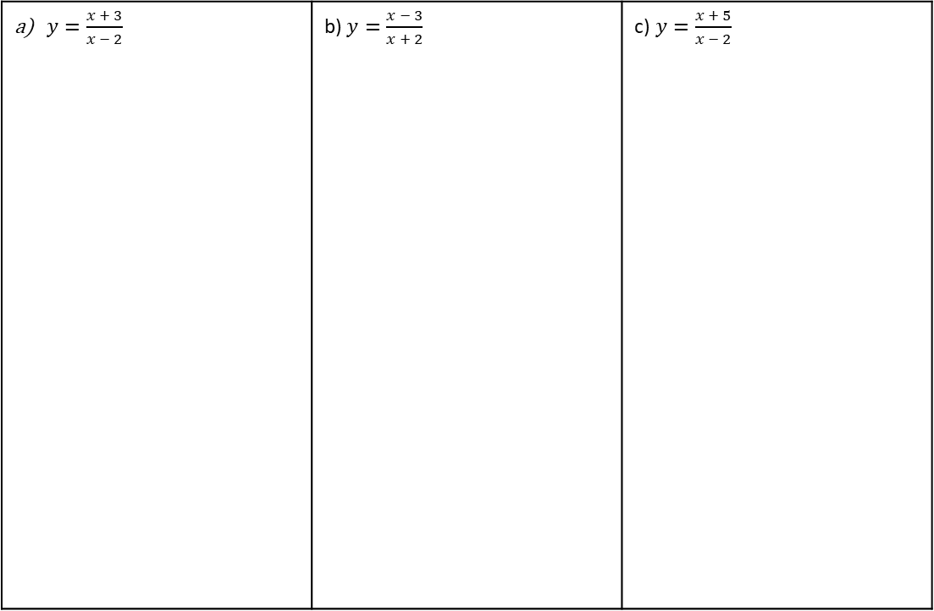
 | Example 16 – I do… | Example 17 - We do… | Example 18 - You do…
Steps | Make $x$the subject of the following: | Make $x$ the subject of the following: | Make $x$ the subject of the following:
1) Circle the subject that we want to isolate. 2) Multiply both sides by the denominator. 3) Expand and simplify the brackets. 4) Rearrange to get the subject on one side. 5) Factorise the subject. 6) Divide both sides of the equation. | $$y=\frac{x+2}{x−2}$$ | $$y=\frac{x+2}{x−3}$$ | $$y=\frac{x−2}{x+2}$$
Independent Practice
Question 7. Make $x$the subject of the following:
$y=\frac{x + 3}{x − 2}$ | b) $y=\frac{x − 3}{x + 2}$ | c)$y=\frac{x + 5}{x − 2}$

Slide 16
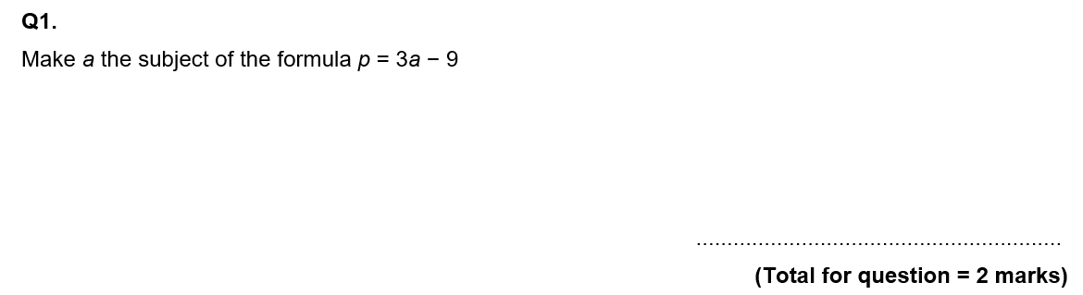
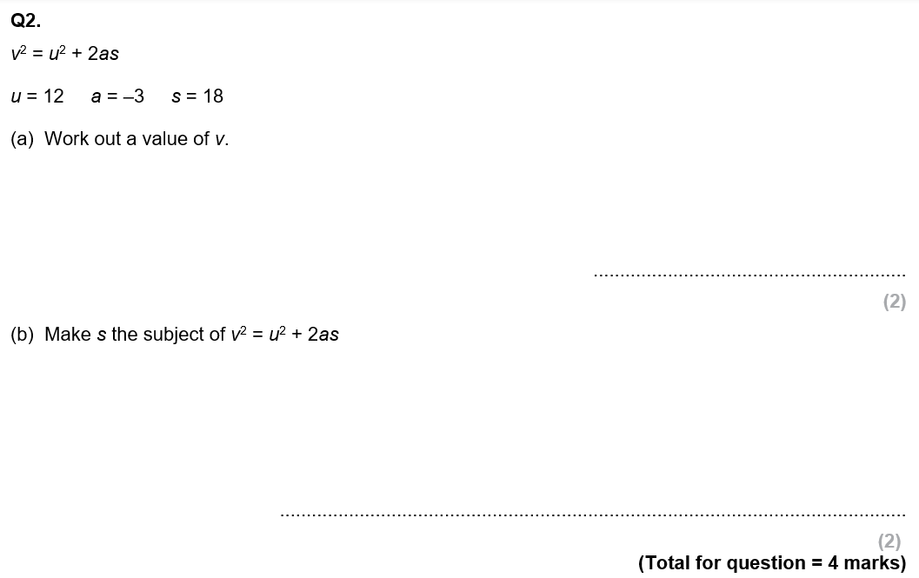
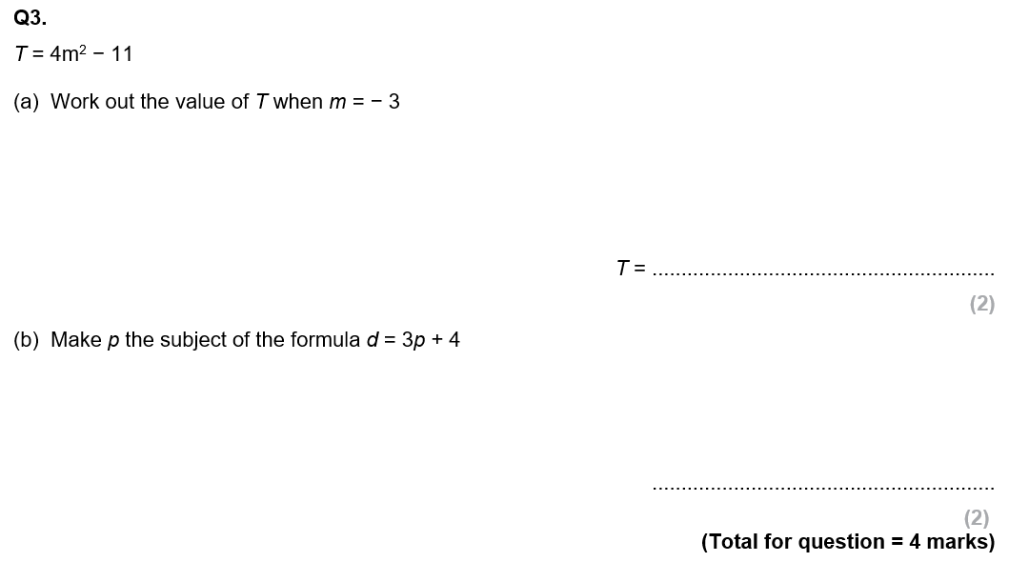
GCSE Past Paper Questions

Slide 17
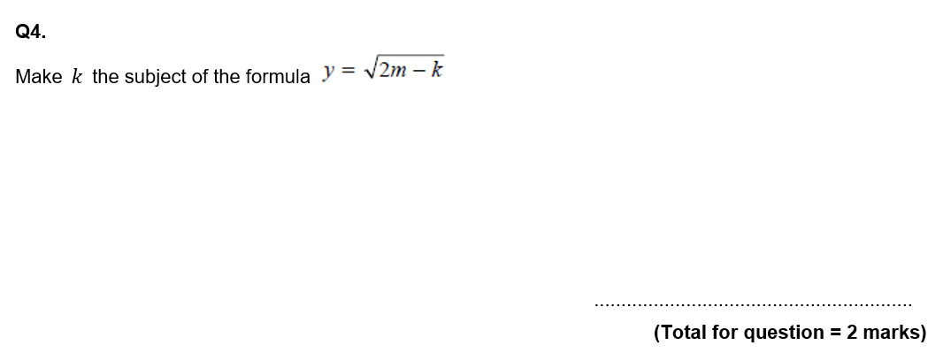
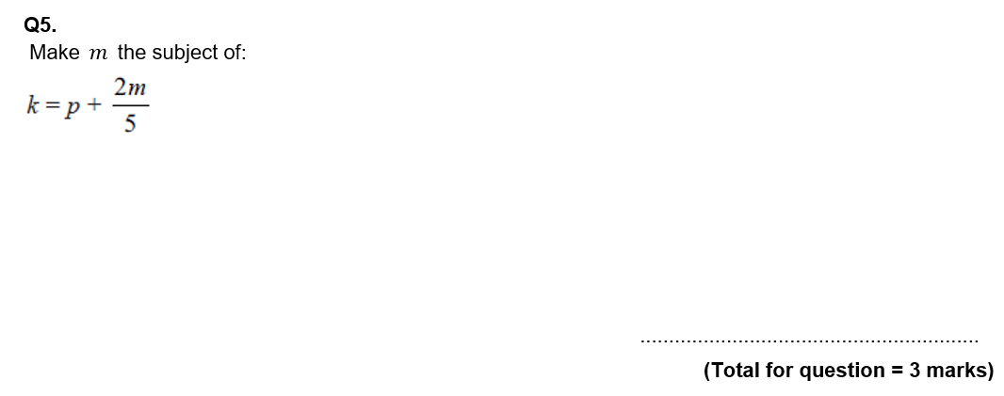
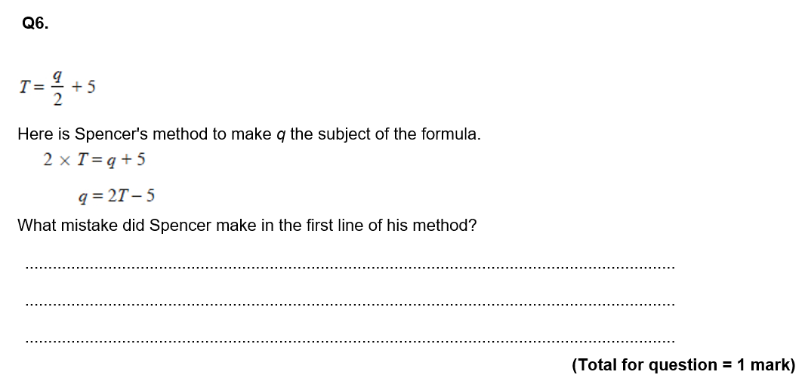

Slide 18
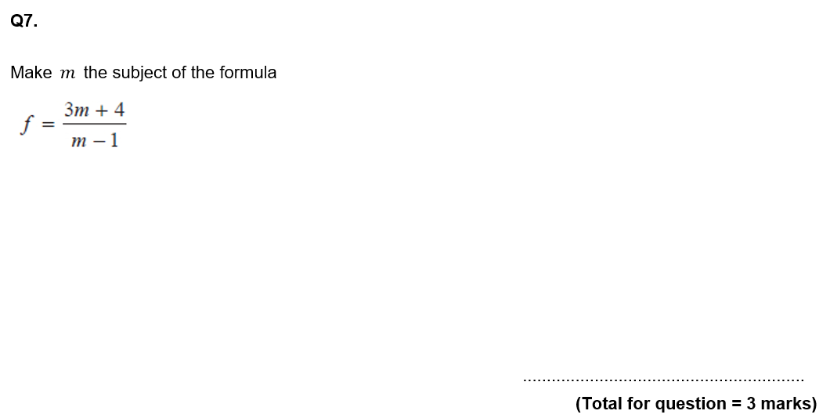
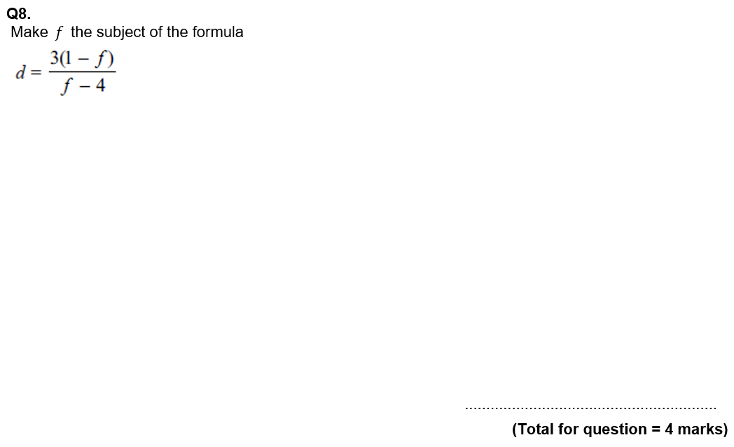

Slide 19
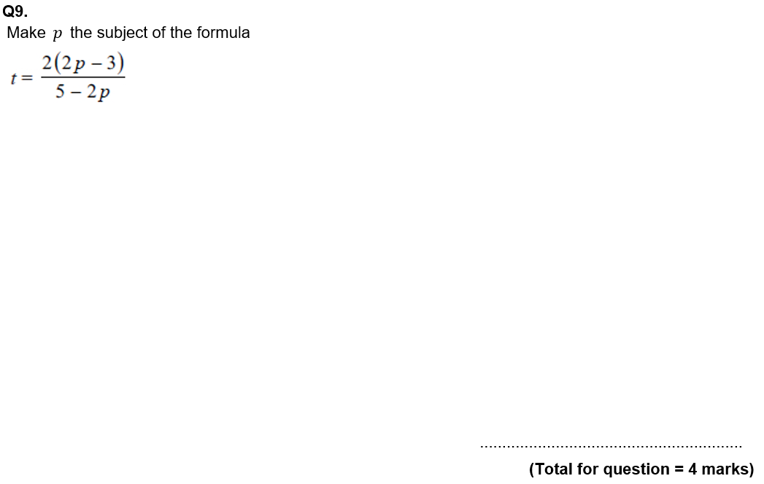
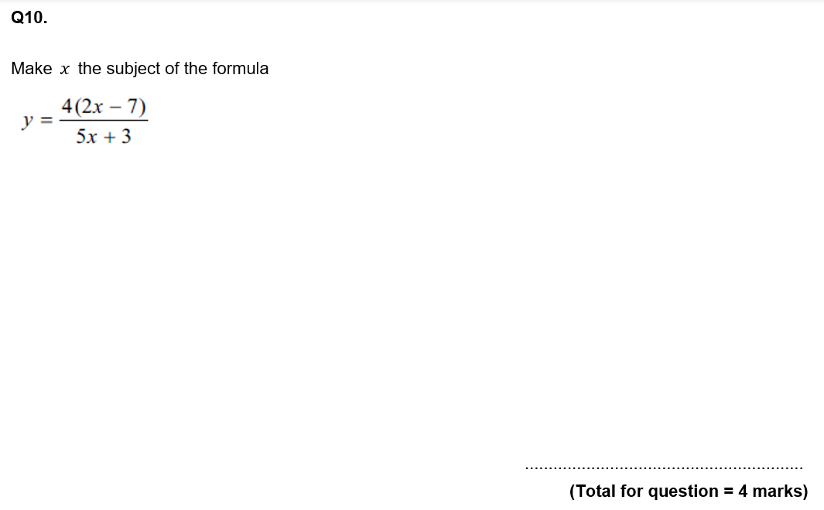

Slide 20
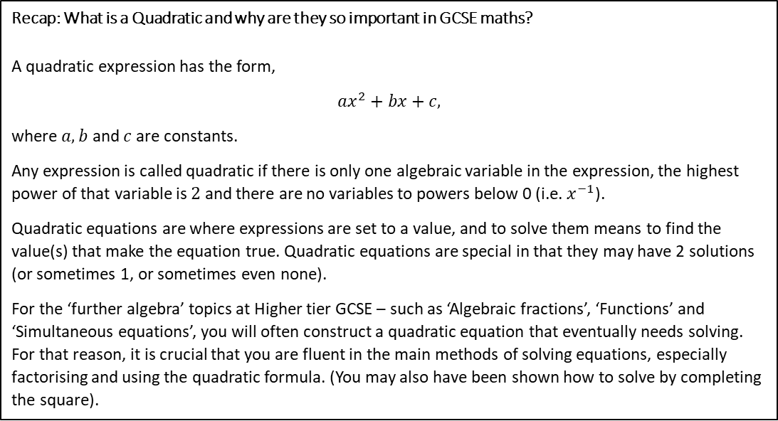







Subtopic 2 – Recap: Solving Quadratic Equations
LEARNING OUTCOME: Recap the core skill of solving quadratics.
Objectives:
To recap the three main methods of solving quadratics:
Factorise
Use the quadratic formula
Complete the square
Recap: What is a Quadratic and why are they so important in GCSE maths?
A quadratic expression has the form,
$$ax^{2}+bx+c,$$
where $a, b$ and $c$ are constants.
Any expression is called quadratic if there is only one algebraic variable in the expression, the highest power of that variable is $2$ and there are no variables to powers below 0 (i.e. $x^{−1}$).
Quadratic equations are where expressions are set to a value, and to solve them means to find the value(s) that make the equation true. Quadratic equations are special in that they may have 2 solutions (or sometimes 1, or sometimes even none).
For the ‘further algebra’ topics at Higher tier GCSE – such as ‘Algebraic fractions’, ‘Functions’ and ‘Simultaneous equations’, you will often construct a quadratic equation that eventually needs solving. For that reason, it is crucial that you are fluent in the main methods of solving equations, especially factorising and using the quadratic formula. (You may also have been shown how to solve by completing the square).
PRIOR KNOWLEDGE QUIZ
1. Solve each equation by factorising first.
You will have to check the equation is in the form $x^{2}+bx+c=0$
a.$x^{2}+4x+4=0$
b. $x^{2}+5x+6=0$
c. $x^{2}+10x+24=0$
d. $x^{2}+20=9x$
e. $x^{2}=12x −20$
f. $15=8x{−x}^{2}$
20

Slide 21









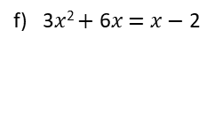

PRIOR KNOWLEDGE QUIZ (CONT.)
2. Solve each equation, by factorising first.
You will have to check the equation is in the form ${ax}^{2}+bx+c=0$
a) 2$x$² $+$ 3$x$ $−$ 35 $=$ 0
b) 4$x$² $−$ 3$x$ $−$ 22 $=$ 0
c) 3$x$² $+$ 4$x$ $−$ 4 $=$ 0
d) 2$x$² $=$ 3$x$ $+$ 5
e) 2$x$² $+$ 1 $=$ 3$x$
f) 3$x$² $+$ 6$x$ $=$ $x$ $−$ 2
3. Solve each equation using the quadratic formula.
You will have to check the equation is in the form ${ax}^{2}+bx+c=0$
$x^{2}+6x+3=0$
b) $2x^{2}+7x+1=0$
c$) x^{2}−7x+1=0$
21

Slide 22
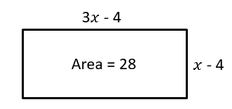
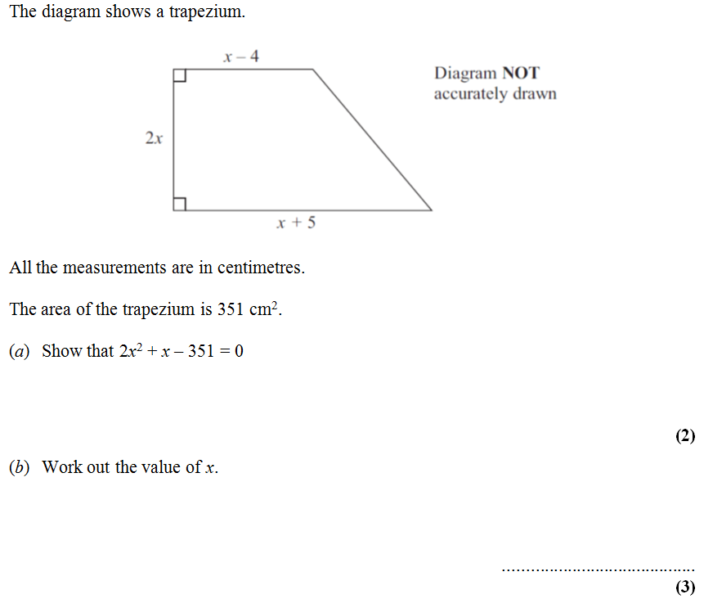
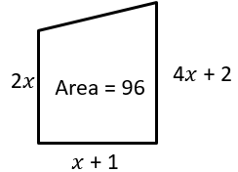



PRIOR KNOWLEDGE QUIZ (CONT.)
Determine the value of $x$:
c) Determine the value of $x$
Solve $\frac{5{\left(2x+1\right)}^{2}}{4x+5}=5x−1$

Slide 23







MIXED PRACTICE (SLOP)
Question 1: Solve these increasingly difficult quadratic equations:

Slide 24


Slide 25








Subtopic 3a – Solving simultaneous equations graphically
LEARNING OUTCOME: Solve simultaneous equations in two variables by the graphical method
Objectives:
Keywords:
Simultaneous equations
Linear equations
Equivalent equations
Intersection
Solve graphical simultaneous equations from a given graph.
Solve graphical simultaneous equations by plotting one or both lines.
Definition
Characteristics
Two equations that form straight lines that intersect at one point.
Linear simultaneous equations are two straight line equations that have an intersection point (this means they cross on the graph).
Examples
Graphical simultaneous equations
Non - Examples
These equations do not intersect, therefore they are not simultaneous.
These are simultaneous equations because they intersect at a point.
KNOWLEDGE CHECK
Do these graphs intersect?
Y N
Y N
Y N
Y N
Y N
Y N

Slide 26












Example 1 - I do…
Example 2 – We do…
The graphs of the straight lines with equations
$3y+2x=12$and $y=x –1$have been drawn on the grid.
The graphs of the straight lines with equations
$y+\frac{1}{2}x+2$and $2y+3x=12$have been drawn on the grid.
Use the graph to solve the simultaneous equations
$3y+2x=12$and $y=x –1$
Use the graph to solve the simultaneous equations
$y+\frac{1}{2}x+2$and $2y+3x=12$
Step 1:
Find the intersection point.
Step 2:
Draw a line from the intersection point to the $x−$axis.
Step 3:
Draw a line from the intersection point to the $y$-axis.
Step 4:
Write the $x$ and $y$ coordinates as the solution.
Step 1:
Find the intersection point.
Step 2:
Draw a line from the intersection point to the $x−$axis.
Step 3:
Draw a line from the intersection point to the $y$-axis.
Step 4:
Write the $x$ and $y$ coordinates as the solution.
$x$ =
$x$ =
$y$ =
$y$ =

Slide 27






Example 3 - You do…
Example 4 – You do…
The graphs of the straight lines with equations
$y=−x+4$and $y=x –2$have been drawn on the grid.
The graphs of the straight lines with equations
$6x+2y−9=0$and $y=2x−3$have been drawn on the grid.
Use the graph to solve the simultaneous equations
$y=−x+4$and $y=x –2$
Use the graph to solve the simultaneous equations
$6x+2y−9=0$and $y=2x−3$
Step 1:
Find the intersection point.
Step 2:
Draw a line from the intersection point to the $x−$axis.
Step 3:
Draw a line from the intersection point to the $y$-axis.
Step 4:
Write the $x$ and $y$ coordinates as the solution.
Step 1:
Find the intersection point.
Step 2:
Draw a line from the intersection point to the $x−$axis.
Step 3:
Draw a line from the intersection point to the $y$-axis.
Step 4:
Write the $x$ and $y$ coordinates as the solution.
$x$ =
$x$ =
$y$ =
$y$ =

Slide 28








INDEPENDENT PRACTICE
1) Solve the simultaneous equations graphically
a)
b)
$x$ =
$x$ =
$y$ =
$y$ =
c)
d)
$x$ =
$x$ =
$y$ =
$y$ =
e)
$x$ =
$y$ =

Slide 29









Example 5 - I do…
Example 6 – We do…
The straight line $y+2x=4$ has been drawn on the grid.
The straight line $y=2x+1$ has been drawn on the grid
a) On the same grid, draw the graph of $y=x+1$
a) On the same grid, draw the graph of $y=x$
$$x$$ | -2 | -1 | 0 | 1 | 2
$$y$$
$$x$$ | -2 | -1 | 0 | 1 | 2
$$y$$
b) Use the graphs to solve the simultaneous equations
$y+2x=4$
$y=x+1$
b) Use the graphs to solve the simultaneous equations
$y=2x+1$
$y=x$
$x$ =
$x$ =
$y$ =
$y$ =

Slide 30










Example 7 - You do…
Example 8 – You do…
The straight line $y=2x$ has been drawn on the grid.
The straight line $y=3x−4$ has been drawn on the grid
On the same grid, draw the graph of
$y=x+4$
On the same grid, draw the graph of
$$y=3x−1$$
$$x$$ | 0 | 1 | 2 | 3 | 4
$$y$$
$$x$$ | -2 | -1 | 0 | 1 | 2
$$y$$
b) Use the graphs to solve the simultaneous equations
$y=2x$
$y=3x−1$
b) Use the graphs to solve the simultaneous equations
$y=3x−4$
$y=x+4$
$x$ =
$x$ =
$y$ =
$y$ =

Slide 31








INDEPENDENT PRACTICE
Solve the simultaneous equations using the graphical method:
2a) The straight line $y=3x$ has been drawn on the grid.
On the same grid draw the graph of
$y=2x+1$
b) use the graph to find the solutions to the simultaneous equations $y=3x$and
$y=x−2$
$$x$$ | -2 | -1 | 0 | 1 | 2
$$y$$
$x$ =
$y$ =
Intersection points:
,
3a) The straight line $y=3x−1$ has been drawn on the grid.
On the same grid draw the graph of
$y=2x+1$
b) use the graph to find the solutions to the simultaneous equations $y=3x−1$and
$y=2x+1$
$$x$$ | -2 | -1 | 0 | 1 | 2
$$y$$
$x$ =
$y$ =
Intersection point:
,

Slide 32



















Subtopic 3b – Recap: Simultaneous equations - Elimination
LEARNING OUTCOME: To recap solving simultaneous equations using the elimination method
Objectives:
Keywords:
Simultaneous equations
Linear equations
Equivalent equations
Intersection
Elimination
To be able to eliminate variables by adding or subtracting equations.
To solve an equation with two variables by substituting a known variable.
Solve simultaneous equations using the elimination method
Definition
Characteristics
A method to eliminate one of the variables in a pair of simultaneous equations to solve for both equations.
You must equate the variables for the elimination method to work.
Examples
Elimination Method
Non - Examples
$$5x+y=11$$
$$4x+y=9$$
$x =2$
$$−$$
$$5\left(2\right)+y=11$$
$$5x+y=11$$
$$4x+y=9$$
$9x+2y=20$
$$5x+y=11$$
$$4x−y=9$$
$x =2$
$$10+y=11$$
$$+$$
$$−$$
$$−10$$
$$−10$$
$$y=1$$
Example 1 - I do… | Example 2 – We do… | Example 3 – You do…
Subtract equation 2 from equation 1. $3x+y=10$ (1) $x+y=5$ (2) | Subtract equation 2 from equation 1. $5x+2y=9$ (1) $3x+2y=5$ (2) | Subtract equation 2 from equation 1. $7x+5y=10$ (1) $3x+5y=5$ (2)
INDEPENDENT PRACTICE
1) subtract equation 2 from equation 1
1) $2x+y=10$ (1)
$x+y=5$ (2)
2) $8x+y=10$ (1)
$5x+y=5$ (2)
3) $3x+3y=10$ (1)
$x+3y=5$ (2)
4) $10x+2y=10$ (1)
$4x+2y=5$ (2)
5)$3x+4y=10$ (1)
$3x+y=5$ (2)
6) $5x+3y=10$ (1)
$5x+y=5$ (2)
7) $7x+3y=10$ (1) $7x+y=5$ (2)
8) $10x+7y=10$ (1)
$10x+2y=5$ (2)

Slide 33









Steps | Example 7 - I do… | Example 8 – We do… | Example 9 – You do…
1) Label the equations 1 and 2. | Solve the simultaneous equations $2x+y=4$ (1) $x+y=3$ (2) | Solve the simultaneous equations $3x+2y=9$ (1) $2x+2y=8$ (2) | Solve the simultaneous equations. $4x+5y=24$ (1) $3x+5y=23$ (2)
2) If the signs are the same for the variables that match subtract.
3) Substitute the value of $x$ or $y$ into one of the equations to find the other values.
4) Write the solutions.
INDEPENDENT PRACTICE
3) Solve the simultaneous equations using elimination
a) $2x+y=5$ (1)
$x+y=4$ (2)
b) $2x+y=4$ (1)
$x+y=3$ (2)
c) $2x+y=8$ (1)
$x+y=6$ (2)
$$x=$$
$$y=$$
$$x=$$
$$y=$$
$$x=$$
$$y=$$
d) $3x+2y=29$ (1)
$2x+2y=24$ (2)
e) $4x+3y=33$ (1)
$3x+3y=30$ (2)
f) $5x+4y=60$ (1)
$4x+4y=56$ (2)
$$x=$$
$$y=$$
$$x=$$
$$y=$$
$$x=$$
$$y=$$

Slide 34





Steps | Example 10 - I do… | Example 11 – We do… | Example 12 – You do…
1) Label the equations 1 and 2. | Solve the simultaneous equations $4x+y=6$ (1) $2x+y=4$ (2) | Solve the simultaneous equations $6x+5y=27$ (1) $2x+5y=19$ (2) | Solve the simultaneous equations. $5x+2y=11$ (1) $2x+2y=8$(2)
2) If the signs are the same for the variables that match subtract.
3) Solve to find one variable.
4) Substitute the value of $x$ or $y$ into one of the equations to find the other values.
5) Write the solutions.
INDEPENDENT PRACTICE
4) Solve the simultaneous equations using elimination
a) $3x+y=6$ (1)
$x+y=4$ (2)
b) $5x+y=13$ (1)
$3x+y=9$ (2)
c) $4x+y=19$ (1)
$x+y=7$ (2)
$$x=$$
$$y=$$
$$x=$$
$$y=$$
$$x=$$
$$y=$$

Slide 35




Steps | Example 13 - I do… | Example 14 – We do… | Example 15 – You do…
1) Label the equations 1 and 2. | Solve the simultaneous equations $4x−y=6$ (1) $2x−y=4$ (2) | Solve the simultaneous equations $5x−2y=11$ (1) $2x−2y=8$(2) | Solve the simultaneous equations. $6x−5y=27$ (1) $2x−5y=19$ (2)
2) If the signs are the same for the variables that match subtract.
3) Solve to find one variable.
4) Substitute the value of $x$ or $y$ into one of the equations to find the other variable.
5) Write the solutions.
INDEPENDENT PRACTICE
5) Solve the simultaneous equations using elimination
a) $3x−y=6$ (1)
$x−y=4$ (2)
b) $5x−y=13$ (1)
$3x−y=9$ (2)
c) $4x−y=19$ (1)
$x−y=7$ (2)
$$x=$$
$$y=$$
$$x=$$
$$y=$$
$$x=$$
$$y=$$

Slide 36














Example 16 - I do… | Example 17 – We do… | Example 18 – You do…
Add the equations together to eliminate the $y$’s $2x+y=7$ (1) $x−y=2$ (2) | Add the equations together to eliminate the $y$’s $3x+2y=16$ (1) $2x−2y=4$ (2) | Add the equations together to eliminate the $y$’s $4x−y=31$ (1) $3x+y=18$ (2)
+
+
+
INDEPENDENT PRACTICE
6) Add the equations together to eliminate the $y$’s
a) $3x+y=4$ (1)
$x−y= 0$(2)
b) $8x−y=8$ (1)
$5x+y=5$ (2)
c) $3x−3y=3$ (1)
$x+3y=5$ (2)
d) $10x−2y=8$ (1)
$4x+2y=6$ (2)
e)$3x−y=4$ (1)
$2x+y=8$ (2)
f) $4x+y=14$ (1)
$5x−y=13$ (2)
g) $8x+2y=28$ (1) $7x−2y=17$ (2)
h) $8x+7y=23$ (1)
$10x−7y=13$ (2)
i)$3x−4y=−5$ (1)
$3x+4y=11$ (2)
j) $5x−8y=−11$ (1)
$5x+8y=21$ (2)
k) $7x+9y=−5$ (1) $7x−9y=−23$ (2)
l) $10x+10y=−50$ (1)
$10x−10y=−70$ (2)

Slide 37






d) $3x+2y=22$ (1)
$2x−2y=8$ (2)
e) $5x−2y=22$ (1)
$2x+2y=20$ (2)
f) $4x+3y=50$ (1)
$2x−3y=−2$ (2)
$$x=$$
$$y=$$
$$x=$$
$$y=$$
$$x=$$
$$y=$$
g) $5x+2y=23$ (1)
$2x−2y=−2$ (2)
h) $5x−3y=0$ (1)
$3x+3y=24$ (2)
i) $4x+4y=44$ (1)
$x−4y=−24$ (2)
$$x=$$
$$y=$$
$$x=$$
$$y=$$
$$x=$$
$$y=$$

Slide 38




INDEPENDENT PRACTICE
8. To solve these equations should we add or subtract?
Circle either the + or -
1.
7.
2.
8.
3.
9.
4.
10.
5.
11.
6.
12.
9. Solve the simultaneous equations
a) $2x+3y=18$
$6x+3y=30$
b) $2x+y=18$
$6x−y=30$
c) $2x+3y=18$
$6x−3y=30$
x = , y =
x = , y =
x = , y =

Slide 39







INDEPENDENT PRACTICE
(d)
$$3x−y=3 \\ 5x+y=13$$
(e)
$$x−y=9$$ $3x+y=11$
(f)
2$x−y=7$ $3x+y=8$
x = , y =
x = , y =
x = , y =
(g)
$$2x−2y=5$$
$$x−2y=3$$
(h)
$$3x−4y=15$$
$$x−4y=3$$
(i)
$$3x−4y=20$$
$$x−4y=8$$
x = , y =
x = , y =
x = , y =

Slide 40

Solving simultaneous equations by adjusting one or both equations
LEARNING OUTCOME: To solve simultaneous equations using the elimination method
Objectives:
Keywords:
Simultaneous equations
Linear equations
Equivalent equations
Intersection
Elimination
Finding the LCM between two numbers.
Solving simultaneous equations by adjusting one equation.
Solving simultaneous equations by adjusting both equations.
Definition
Characteristics
Two equations that form straight lines that intersect at one point.
Linear simultaneous equations are two straight line equations that have an intersection point (this means they cross on the graph).
Examples
Simultaneous Equations
Non - Examples
These equations do not intersect, therefore they are not simultaneous.
These are simultaneous equations because they intersect at a point.
SKILLS CHECK
1) Find the lowest common multiple of these numbers
a) 3 and 9
b) 4 and 12
c) 10 and 30
d) 7 and 28
e) 21 and 42
Steps | Example 1 - I do… | Example 2 – We do… | Example 3 – You do…
1) Find the LCM of the variables. | Adjust one of the equations to make the $y^{′}s$the same. $2x+y=7$ (1) $x−3y=10$ (2) | Adjust one of the equations to make the $y^{′}s$the same $3x+4y=16$ (1) $2x+2y=4$ (2) | Adjust one of the equations to make the $y^{′}s$the same $4x−21y=31$ (1) $3x+7y=18$ (2)
2) Multiply one of the equations to make the variables the same.

Slide 41







Adjusting one equation
Steps | Example 4 - I do… | Example 5 – We do… | Example 6 – You do…
1) Label the equations 1 and 2. | Solve the simultaneous equations $2x+y=17$ (1) $3x+2y=29$ (2) | Solve the simultaneous equations $3x+y=19$ (1) $6x+3y=42$ (2) | Solve the simultaneous equations. $4x+y=11$ (1) $x+3y=11$ (2)
2) Find the LCM and adjust one of the equations.
3) If the signs are the same, subtract. If different, add.
4) Solve to find one variable.
5) Substitute the value of $x$ or $y$ into one of the equations to find the other values.
6) Write the solutions.
INDEPENDENT PRACTICE
2) Solve the simultaneous equations using elimination
a) $2x+y=5$ (1)
$3x+2y=9$ (2)
b) $2x+2y=12$ (1)
$3x+4y=22$ (2)
c) $2x+3y=28$ (1)
$3x+6y=51$ (2)
$x$ = , $y$ =
$x$ = , $y$ =
$x$ = , $y$ =

Slide 42





Steps | Example 7 - I do… | Example 8 – We do… | Example 9 – You do…
1) Label the equations 1 and 2. | Solve the simultaneous equations $2x+y=5$ (1) $3x−2y=−3$ (2) | Solve the simultaneous equations $3x−y=11$ (1) $6x+3y=27$ (2) | Solve the simultaneous equations. $4x+y=22$ (1) $x−3y=−1$ (2)
2) Find the LCM and adjust one of the equations.
3) If the signs are the same, subtract. If different, add.
4) Solve to find one variable.
5) Substitute the value of $x$ or $y$ into one of the equations to find the other values.
6) Write the solutions.
INDEPENDENT PRACTICE
3) Solve the simultaneous equations using elimination
a) $2x−2y=6$ (1)
$3x+4y=16$ (2)
b) $2x+3y=16$ (1)
$3x−6y=3$ (2)
c) $2x−y=−1$ (1)
$3x+2y=9$ (2)
$x$ = , $y$ =
$x$ = , $y$ =
$x$ = , $y$ =

Slide 43







MIXED PRACTICE
4) Solve the simultaneous equations using elimination
a) $2x+8y=43$ (1)
$x+3y=18$ (2)
b) $5x−3y=33$ (1)
$3x−9y=63$ (2)
c) $2x+4y=−2$ (1)
$4x+2y=−10$ (2)
$x$ = , $y$ =
$x$ = , $y$ =
$x$ = , $y$ =
d) $8x+4y=−28$ (1)
$3x−12y=30$(2)
e) $15x−4y=82$ (1)
$5x−9y=12$ (2)
f) $12x+3y=9$ (1)
$2x+11y=−9$ (2)
$x$ = , $y$ =
$x$ = , $y$ =
$x$ = , $y$ =

Slide 44




Adjusting both equations
Steps | Example 10 - I do… | Example 11 – We do… | Example 12 – You do…
1) Label the equations 1 and 2. | Solve the simultaneous equations $4x+2y=8$ (1) $3x+3y=9$ (2) | Solve the simultaneous equations $3x+2y=13$ (1) $6x−5y=8$ (2) | Solve the simultaneous equations. $4x+3y=29$ (1) $x+5y=20$ (2)
2) Find the LCM and adjust both of the equations.
3) If the signs are the same, subtract. If different, add.
4) Solve to find one variable.
5) Substitute the value of $x$ or $y$ into one of the equations to find the other values.
6) Write the solutions.
6) Solve the simultaneous equations by adjusting both equations
a) $2x+2y=14$ (1)
$5x−3y=19$ (2)
b) $2x+3y=1$ (1)
$7x+2y=−22$ (2)
c) $5x+3y=−4$ (1)
$2x+4y= 4$ (2)

Slide 45






g) $3x+8y=31$ (1)
$5x+3y=31$ (2)
h) $7x−15y=2.5$ (1)
$3x−2y=5.5$ (2)
i) $3x+2y=53$ (1)
$2x+5y=72$ (2)
$x$ = , $y$ =
$x$ = , $y$ =
$x$ = , $y$ =
j) $5x−3y=18$ (1)
$2x+4y=54$(2)
k) $2x+8y=8$ (1)
$9x+3y=−63$ (2)
l) $2x−4y=4$ (1)
$5x−3y=24$ (2)
$x$ = , $y$ =
$x$ = , $y$ =
$x$ = , $y$ =

Slide 46



3) Solve the simultaneous equations by rearranging and then using elimination.
a) $x=10−y$ (1)
$2x+y=17$ (2)
b) $x−4=y$ (1)
$x+3y=12$ (2)
c) $2x+6y=4$ (1)
$x=12+2y$ (2)
$x$ = , $y$ =
$x$ = , $y$ =
$x$ = , $y$ =
4) Two cats and a dog cost £91.
Three cats and two dogs cost £159.
How much does a cat cost?
Hint: form equations

Slide 47
Subtopic 3c – Simultaneous equations – Worded Problems
LEARNING OUTCOME: To solve simultaneous equations in worded problems
Objectives:
Keywords:
Simultaneous equations
Linear equations
Equivalent equations
To recognise simultaneous equations in worded problems.
To be able to write worded problems as two coherent simultaneous equations, and solve these.
To be able to interpret the answers to worded simultaneous equations problems.
Definition
Characteristics
Two equations that form straight lines that intersect at one point.
Linear simultaneous equations are two straight line equations that have an intersection point (this means they cross on the graph).
Examples
Simultaneous equations
Non - Examples
These equations do not intersect, therefore they are not simultaneous.
These are simultaneous equations because they intersect at a point.
Key steps
Convert each sentence to an equation.
Solve the simultaneous equations.
Answer the question.
Example 1 - I do…
David buys 2 scones and 2 coffees in a shop and the cost is £18.
Eliza buys 3 scones and 2 coffees in the same shop and they cost £22.
Find the cost of each scone and each coffee.

Slide 48
Example 2 – We do…
The cost of buying a coffee and a tea in a café is £4.
The cost of buying a coffee and three teas in a café is £7.
Work out the cost of buying 2 coffees and the cost of buying 3 teas.
Example 3 – You do…
Five adult tickets and three child tickets for a movie cost £58.
Two adult tickets and eight child tickets for a movie cost £47.
Find the cost of each type of ticket.

Slide 49
INDEPENDENT PRACTICE
1. Solve the following
a) Sweets are sold in small packs and in big packs.
There is a total of 175 sweets in 4 small packs and 3 big packs.
There is a total of 154 sweets in 5 small packs and 2 big packs.
Work out the number of sweets in each small pack and in each big pack.
b) A plumber charges a price for each hour, £h, and a fixed charge, £c.
A 5 hour job costs £155 in total.
A 8 hour job costs £230 in total.
How much would a job that lasts 2 hours cost?
c) The sum of Rosemary’s age and Hannah’s age is 102 years.
The difference between Rosemary’s age and Hannah’s age is 52 years.
Rosemary is older than Hannah.
Find the age of each woman by using simultaneous equations.

Slide 50
3. Solve the following
a) Four sacks of potatoes and two sacks of carrots weigh 188 lb.
Five sacks of potatoes and one sack of carrots weigh 202 lb.
Baz buys seven sacks of potatoes and eight sacks of carrots.
Will he be able to carry them in his trailer, which can safely carry 450 lb?
b) In this sequence, the next term is found by multiplying the previous term by a and then adding b, where a and b are positive whole numbers.
3 14 47 … …
An equation that links the first and second terms is 3a + b = 14.
Set up another equation in a and b.
Solve the equations to work out a and b.
Work out the next two terms in the sequence.
c) Five bags of bark and four trays of pansies cost £24.50. One bag of bark and five trays of pansies cost £12.25. Camilla wants six bags of bark and eight trays of pansies. She has £30. Will she have enough money?

Slide 51


4. Solve the following
Albie is training for a marathon.
He jogs either route A or route B.
During April, he jogs route A nine times and route B five times.
Route B is 8 miles longer than route A.
In total, he jogs 89 miles in April.
In May, he will start jogging route C.
Route C is 20% longer than route B.
Work out the length of route C.
b) Shown below is parallelogram.
Each side is measured in centimetres.
Work out the perimeter of the parallelogram.
c) Solve the simultaneous equations
$$6x+2y=13c$$
$$x+2y=−2c$$
Where c is a constant
Give your answer in terms of c.

Slide 52



GCSE QUESTIONS

Slide 53




Slide 54




Slide 55




Slide 56




Subtopic 3d – Solving Simultaneous Equations by Substitution
LEARNING OUTCOME: To solve simultaneous equations using the substitution method
Objectives:
Keywords:
Simultaneous equations
Linear equations
Equivalent equations
Intersection
Elimination
Solving simultaneous equations by substitution.
Solving simultaneous equations by adjusting and then substituting.
Definition
Characteristics
One equation is substituted into the other. This equation will often need to be expanded before it can be solved.
One equation may have x or y as it’s subject.
e.g. $4x−y=17$and $y=x−2$
Examples
Substitution method
Non - Examples
Solve simultaneously
$$y=2x+1$$
$$5x+3y=14$$
Substitute $2x+1$ for y into second equation
$$5x+3\left(2x+1\right)=14$$
Expand and solve for $x$, before finding $y.$
For these equations you would use the elimination method to solve simultaneously.
$$4x+y=17$$
$$2x+y=9$$
Steps | Example 1 - I do… | Example 2 – We do… | Example 93– You do…
1) Label the equations 1 and 2. | Solve the simultaneous equations $$y=2x−3$$ $$5x−3y=11$$ | Solve the simultaneous equations $$5x+2y=43$$ $$x=y−4$$ | Solve the simultaneous equations. $$4x+3y=88$$ $$y=2x+6$$
2) Substitute isolated variable into equation 2.
3) Expand
4) Simplify
5) Solve
6) Substitute known variable to find the unknown variable.

Slide 57






INDEPENDENT PRACTICE
1. Solve the simultaneous equations by substitution
a) $y=2x$
$x+y=6$
b) $y=x+2$ $$2x+y=11$$
c) $x=y+3$
$$x+2y=15$$
$x$ = , $y$ =
$x$ = , $y$ =
$x$ = , $y$ =
d) $x=2y$
$$7x−2y=60$$
$$y=3x$$
$$x+2y=14$$
f) $y=x+3$
$$y−1=2x$$
$x$ = , $y$ =
$x$ = , $y$ =
$x$ = , $y$ =

Slide 58


Subtopic 3e – Quadratic simultaneous equations
LEARNING OUTCOME: To solve simultaneous equations using the substitution method
Objectives:
Keywords:
Simultaneous equations
Linear equations
Equivalent equations
Intersection
Elimination
Finding the LCM between two numbers.
Solving simultaneous equations by adjusting one equation.
Solving simultaneous equations by adjusting both equations.
When solving simultaneous equations that involve a quadratic the elimination method will not be sufficient. Therefore, we need to use a substitution method. We will look to substitute a linear equation into the quadratic. As one equation is a quadratic you can receive two sets of answers to these equations. (i.e. 2 values for $x$and 2 values for $y$). It is important that you give these solutions as pairs.
Steps | Example 1 - I do… | Example 2 – We do… | Example 3 – You do…
1) Set each equation equal to each other. | Solve the simultaneous equations $$y=x^{2}+x−2$$ $$y=2x+4$$ | Solve the simultaneous equations $$y=x^{2}+7x−2$$ $$y=x+4$$ | Solve the simultaneous equations $$y=x^{2}−3$$ $$y=2x+5$$
2) Rearrange to = 0
3) Solve by either: a) Factorising b) Quadratic Formula
4) Substitute $x$ values to find $y$
5) Write solutions in pairs

Slide 59




INDEPENDENT PRACTICE
2. Solve the quadratic simultaneous equations.
a) $y=x^{2}+5x−2$
$y=x+3$
b) $y=x^{2}−9x−3$ $$y=x$$
$x$ = , $y$ =
$x$ = , $y$ =
$x$ = , $y$ =
$x$ = , $y$ =
c) $y=x^{2}+3x−2$
$$y=−x+3$$
d) $y=x^{2}−3x−2$
$$y=x−8$$
$x$ = , $y$ =
$x$ = , $y$ =
$x$ = , $y$ =
$x$ = , $y$ =

Slide 60




e) $y=x^{2}−5x−2$
$$y=−x+3$$
f) $y=x^{2}−3$
$$y=x−3$$
$x$ = , $y$ =
$x$ = , $y$ =
$x$ = , $y$ =
$x$ = , $y$ =
g) $y={2x}^{2}+x+1$
$$y=x^{2}−5x−7$$
h) $y={−x}^{2}+5x+2$
$$y={3x}^{2}−x−2$$
$x$ = , $y$ =
$x$ = , $y$ =
$x$ = , $y$ =
$x$ = , $y$ =

Slide 61


Expand the following:
KNOWLEDGE CHECK
a) ${(x+1)}^{2}$ | b) ${(x−1)}^{2}$ | c) ${(2x−3)}^{2}$
Steps | Example 4 - I do… | Example 5 – We do… | Example 6 – You do…
1) Substitute linear equation into quadratic | Solve the simultaneous equations $$x^{2}+y^{2}=9$$ $$y=x+3$$ | Solve the simultaneous equations $$x^{2}+y^{2}=20$$ $$x=y−3$$ | Solve the simultaneous equations $$x^{2}+y^{2}=17$$ $$x=y−5$$
2) Expand and Simplify
3) Rearrange to = 0
3) Solve by either: a) Factorising b) Quadratic Formula
4) Substitute $x$ values to find $y$
5) Write solutions in pairs

Slide 62




INDEPENDENT PRACTICE
3. Solve the quadratic simultaneous equations.
a) $x^{2}+y^{2}=25$
$$y=x−5$$
b) $x^{2}+y^{2}=4$
$$x=y−2$$
$x$ = , $y$ =
$x$ = , $y$ =
$x$ = , $y$ =
$x$ = , $y$ =
c) $x^{2}+y^{2}=20$
$$y=x+3$$
d) $x^{2}+y^{2}=25$
$y=2x+5$
$x$ = , $y$ =
$x$ = , $y$ =
$x$ = , $y$ =
$x$ = , $y$ =

Slide 63


KNOWLEDGE CHECK
Expand the following:
a) $x(x−1)$ | b) $x(2x−1)$ | c) $4x(x−1)$
Steps | Example 7 - I do… | Example 8 – We do… | Example 9 – You do…
1) Substitute isolated equation into the quadratic | Solve the simultaneous equations $$xy=2$$ $$y=x+1$$ | Solve the simultaneous equations $$xy=2$$ $$y=x−1$$ | Solve the simultaneous equations $$xy=12$$ $$y=x+1$$
2) Expand and Simplify
3) Rearrange to = 0
3) Solve by either: a) Factorising b) Quadratic Formula
4) Substitute $x$ values to find $y$
5) Write solutions in pairs

Slide 64




INDEPENDENT PRACTICE
4. Solve the quadratic simultaneous equations.
a) $xy=12$
$$y=x−1$$
b) $xy=12$
$$y=x−4$$
$x$ = , $y$ =
$x$ = , $y$ =
$x$ = , $y$ =
$x$ = , $y$ =
c)$xy=12$
$$y=x+4$$
d) $xy=12$
$$y=2x+5$$
$x$ = , $y$ =
$x$ = , $y$ =
$x$ = , $y$ =
$x$ = , $y$ =

Slide 65




MIXED PRACTICE
a) $xy=24$
$$y=3x−1$$
b) $xy=12$
$$2y=x+5$$
$x$ = , $y$ =
$x$ = , $y$ =
$x$ = , $y$ =
$x$ = , $y$ =
c) $xy=12$
$2y=x−5$
d) $4xy=12$
$$y=x−2$$
$x$ = , $y$ =
$x$ = , $y$ =
$x$ = , $y$ =
$x$ = , $y$ =

Slide 66




e) $x^{2}+y^{2}=25$
$$y=2x−5$$
f) ${2x}^{2}+y^{2}=17$
$$y=x+5$$
$x$ = , $y$ =
$x$ = , $y$ =
$x$ = , $y$ =
$x$ = , $y$ =
g) ${2x}^{2}+y^{2}=10$
$$y=2x−5$$
h) $x^{2}+{2y}^{2}=11$
$$x=5−2y$$
$x$ = , $y$ =
$x$ = , $y$ =
$x$ = , $y$ =
$x$ = , $y$ =

Slide 67






5. Solve the quadratic simultaneous equations.
a) $y=x+1$
$$y=1+\frac{4}{x}$$
b) $xy=9$
$$y=x$$
c)$x^{2}+y^{2}=50$
$$y=x$$
$x$ = , $y$ =
$x$ = , $y$ =
$x$ = , $y$ =
$x$ = , $y$ =
$x$ = , $y$ =
$x$ = , $y$ =
6**.

Slide 68


GCSE QUESTIONS

Slide 69




Slide 70




